Slide 1
Novato High School Improvement Blueprint Three Areas of Focus

Slide 2
Culture of Caring:
Positive Behavior Interventions and Supports – PBIS
Restorative Practices
Wellness Campus – East Annex
Communications(FAM & FAM-FAM).
Proficiency Based Education:
English Language Development – Equity
Graduate Profile - 6C’s
Essential Standards and Proficiency Scales
Assessment and Mastery Based Grading.
Multi-Tiered Systems of Support - MTSS:
Office Hours/Targeted tutorials/Social Emotional Learning/Math support class.
Participating on District MTSS development team.

Slide 3
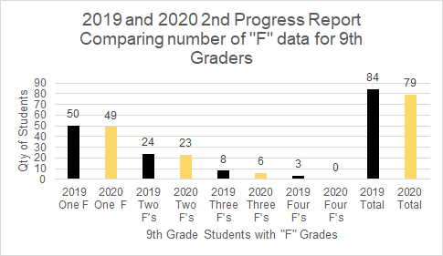

Slide 4
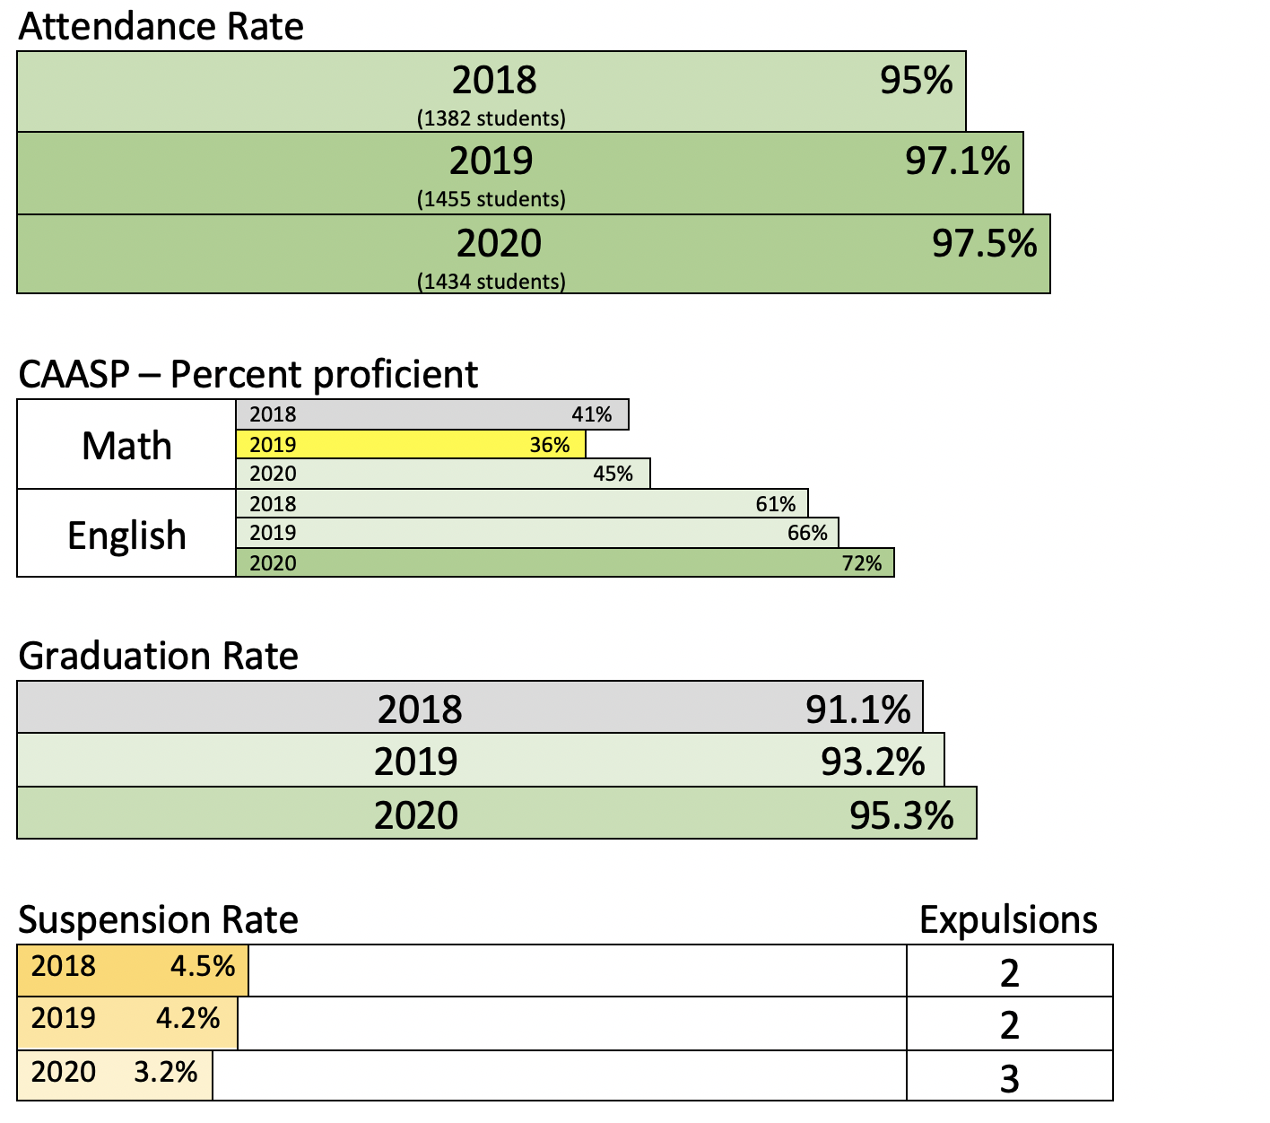
NHS 3-year trend data

Slide 5
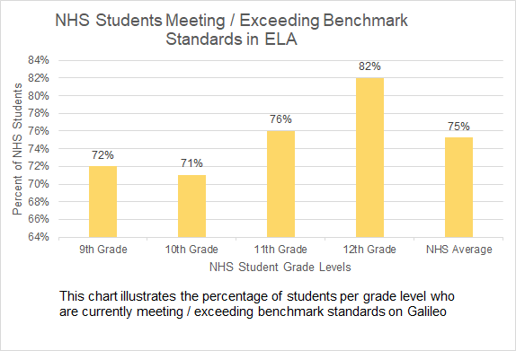

Slide 6
NHS Average SAT/ACT Data 2019
NHS Exceeds national average in all measures!
 | National Average | NHS
Total SAT composite score top score1600 (n=# tested) | 1050 (n=2.2 million) | 1190 (n=334)
SAT Math | 528 | 590
SAT Verbal | 531 | 600
Total ACT composite score top score 36 (n=# tested) | 20.9 (n=1.78 million) | 27 (n=130)
ACT Math | 20.3 | 26
ACT Reading | 21.2 | 28
ACT English | 20.1 | 28
ACT Science | 20.6 | 26

Slide 7
Youth Truth data for NHS.
Percent agree/strongly agree
Question: Jan 2018 Jan 2019 Jan 2020 3 yr growth
Administrators treat staff with respect 48% 78% 81% +33%
Staff and administrators care about each other 49% 58% 75%. +26%
Teachers at my school work together 62% 71%. 78%. +16%
to improve instructional practice
My school is cooperative and team oriented 41%. 57%. 72%. +31%
I feel comfortable approaching the administration 62% 70%. 72%. +10%
if I need help solving a problem
I understand my school’s goals overall 61%. 50%. 82%. +21%
I feel my work contributes to the school goals 77%. 86%. 90%. +13%
overall
My school empowers me to be creative in how 52% 71% 76% +24%
I do my work
I feel empowered to play a meaningful role in. 40% 44% 45% +5%
decision-making at my school

Slide 9
Thank You! Be Responsible Be Kind Be Well Novato High School

